Slide 1
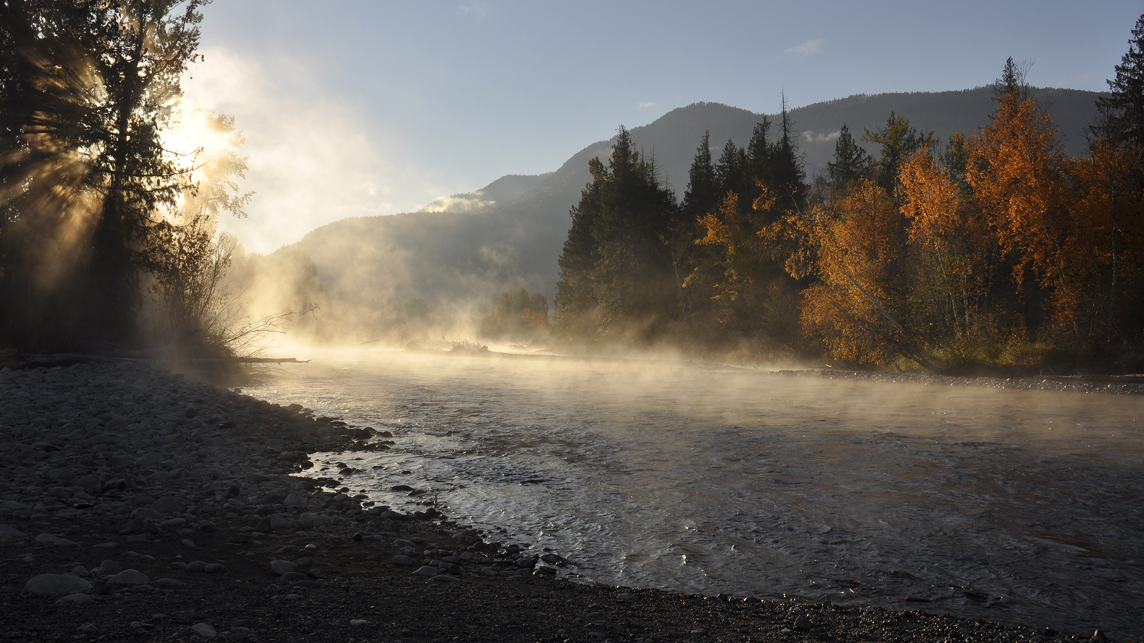
Preliminary 2025 Pacific Salmon Outlook

Slide 2
PRESENTATION OUTLINE
Introduction
Area Outlooks
Discussion
Conclusion
Fraser and Interior
North Coast
South Coast
Yukon Transboundary
Chinook
Chum
Coho
Sockeye
Pink
Chinook
Chum
Coho
Sockeye
Pink
Chinook
Chum
Coho
Sockeye
Pink
Chinook
Chum
Coho
Sockeye
Pink

Slide 3
INTRODUCTION
The Salmon Outlook provides an estimate of expected abundance of salmon in 2025 to inform the harvest planning process.
This Outlook provides a categorical abundance expectation-based expert opinion as well as expected abundance for those stock units with statistical forecasts.

Slide 4
INTRODUCTION
Stock Management Units
A salmon ‘stock management unit’ (SMU) is a ‘group of one or more conservation units (CUs) that are managed together with the objective of achieving a joint status, meaning harvest control rules would apply to the aggregate in most cases.
Use of SMUs does not preclude considerations related to conserving CU-level diversity but rather is a practical aggregation of CUs for harvest planning and reporting purposes. It is the scale at which harvest management plans or management and assessment procedures, are developed in Integrated Fisheries Management Plans (IFMPs)
In many cases, elements of the Precautionary Approach are implemented at finer scales of organization within a SMU.

Slide 5
INTRODUCTION
Biological and Management References
The purpose of a stock forecast or outlook is to provide information to harvest managers to potentially adjust harvest plans according to the expected stock abundance.
Where biological benchmarks and/or limit reference points are defined for CUs or SMUs, they are noted in the final Outlook document. Similarly, if management targets are in place they are identified.
Lack of these references is a gap, and work is on-going to develop methods and complete the analyses to define these references.

Slide 6
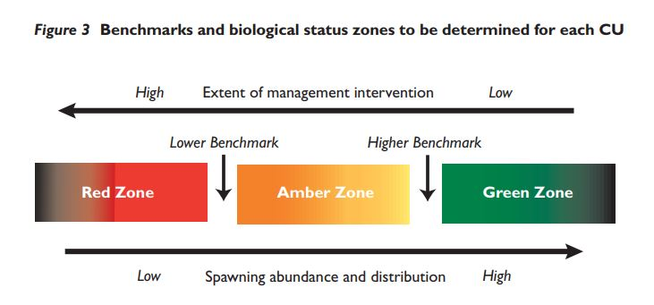
INTRODUCTION
For implementation of the Wild Salmon Policy, the status of salmon Conservation Units (CU) is assessed against ‘biological benchmarks’

Slide 7
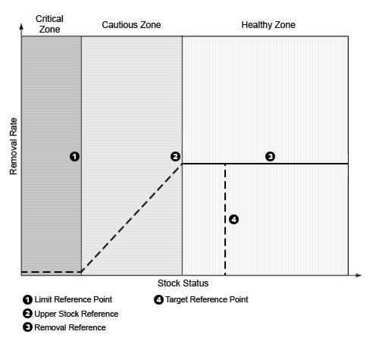
INTRODUCTION
DFO’s general ‘Precautionary Approach’
For harvest management:

Slide 8
INTRODUCTION
Outlook Categories
Outlook Category | CUs or SMUs with references |  | Data Limited CUs or SMUs
 | Wild Salmon Policy (CU Level) | Precautionary Approach (SMU Level) | Category Definition | Expected spawning abundance
1 | Red Zone (i.e. below the LBB) | Critical Zone (i.e. below the LRP) | Well below average | <25th percentile
2 | Amber Zone (i.e. below the LBB, below the UBB) | Cautious Zone (i.e. above the LRP below the USR) | Below Average | 25 to 40th percentile
3 | Green Zone (i.e. above the UBB) | Healthy Zone (i.e. above the USR) | Near Average | 40 to 60th percentile
4 | Green Zone (i.e. at or above the TRP) | Healthy Zone (i.e. at or above the TRP) | Abundant | >60th percentile
Data Deficient |  |  | Insufficient information | Unknown

Slide 9
INTRODUCTION
Contributors
The Outlook document reflects the contribution and work of many stock assessment biologists across the region.
Much of the data and information used to create outlooks, status assessments and forecasts, is generated through collaborative programs involving First Nations and other stakeholders and stewardship groups.

Slide 10
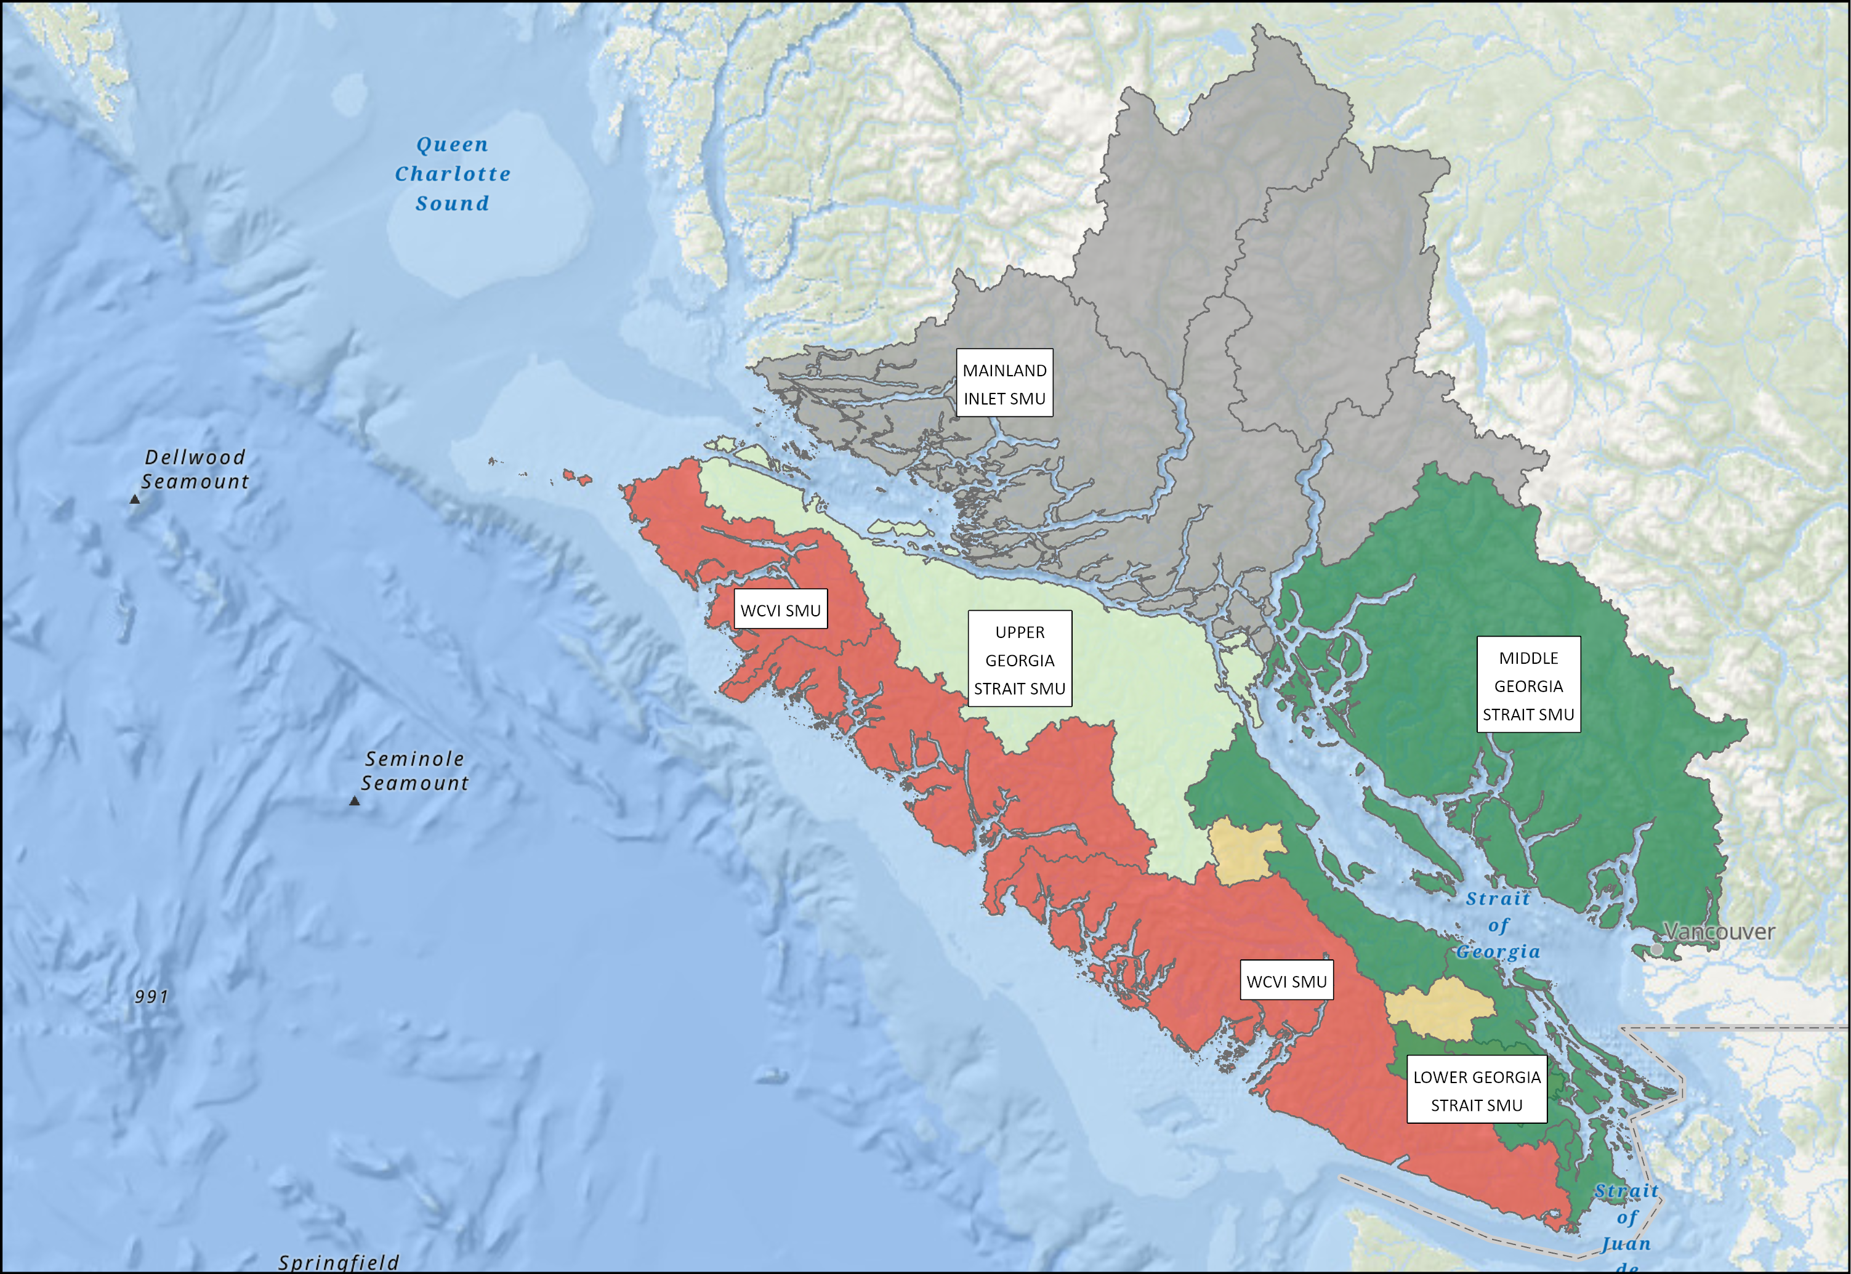
YUKON TRANSBOUNDARY - SOCKEYE
South Coast Area - Chinook
SMU | CU / Subunit | Outlook
Mainland Inlet | Aggregate (4 CUs) | DD
Upper Georgia Strait | Quinsam River Fall Run | 3
Middle Georgia Strait | Puntledge and Big Qualicum Rivers Fall Run Enhanced | 4
Middle Georgia Strait | Nanaimo and Puntledge Summer Enhanced | 1-2
Lower Georgia Strait | Cowichan River Fall Run Unenhanced | 4
West Coast Vancouver Island | Aggregate ( ?? CUs) | 2
Notes:
Expectations are for an average Somass Sockeye return in 2025, based on ocean indicators returns to date, and marine survival rates
Henderson: The 2024 adult return was low. The age composition data showed similar abundances of 42s and 52s. Expectations are for a below-average return.

Slide 11
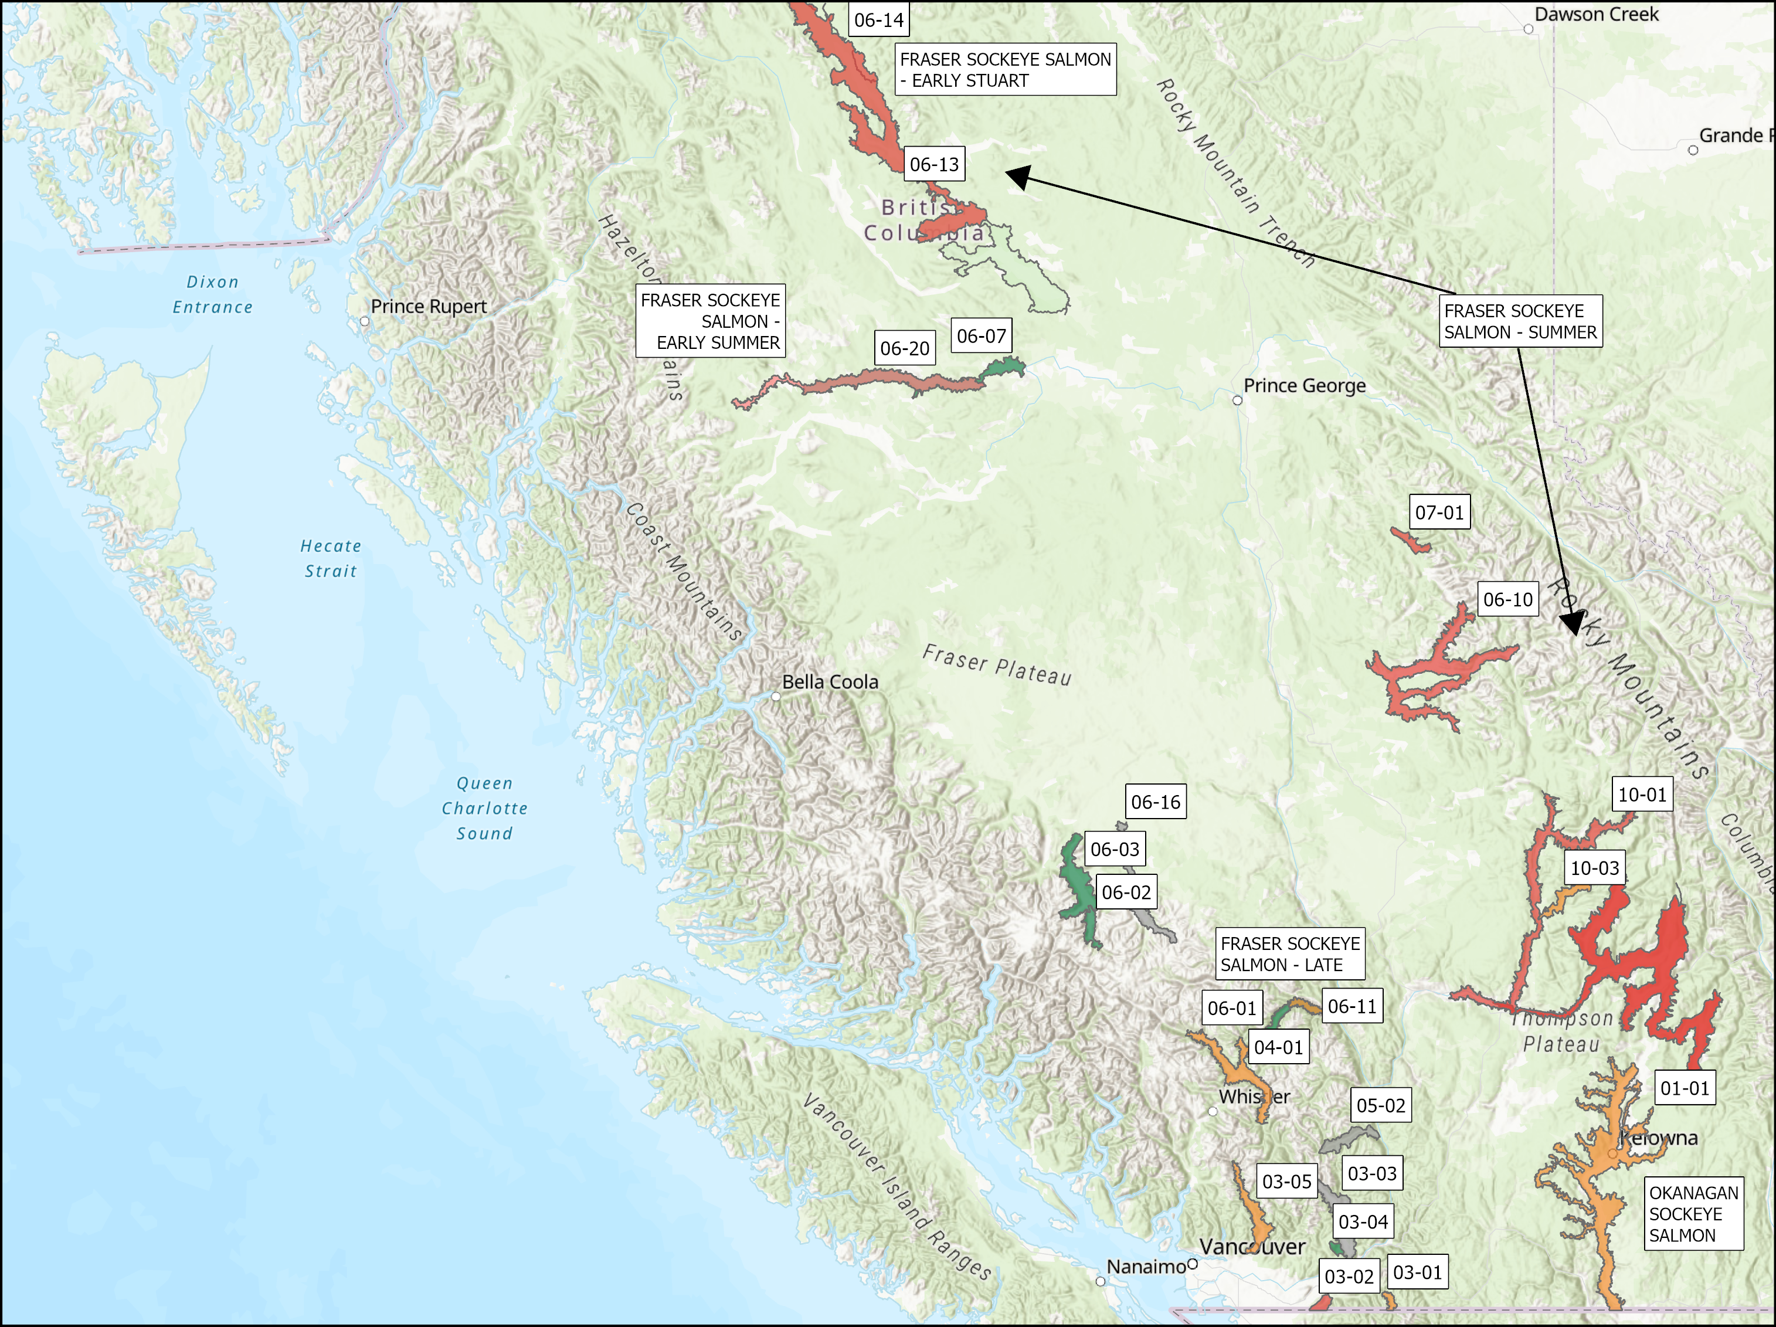
FRASER AND INTERIOR – SOCKEYE
SMU | CU / Subunit | Outlook
Fraser Sockeye Salmon -Early Stuart | Takla/ Trembleur-Early Stuart Timing | 1
Lower Fraser | CHILLIWACK-EARLY SUMMER TIMING | 1-4
Lower Fraser | PITT-EARLY SUMMER TIMING | 1-3
Lower Fraser | NAHATLATCH-EARLY SUMMER TIMING | NA
South Thompson | SHUSWAP-EARLY SUMMER TIMING (Seymour and Scotch) | 1
North Thompson | NORTH BARRIERE-EARLY SUMMER TIMING | 2
Mid and Upper Fraser | ANDERSON/SETON-EARLY SUMMER TIMING | 4
Mid and Upper Fraser | NADINA/FRANCOIS-EARLY SUMMER TIMING | 1-2
Mid and Upper Fraser | BOWRON-EARLY SUMMER TIMING | 1
Mid and Upper Fraser | TASEKO-EARLY SUMMER TIMING | NA
Fraser Sockeye Salmon - Summer | HARRISON RIVER | 1-2
Fraser Sockeye Salmon - Summer | QUESNEL-SUMMER TIMING | 1
Fraser Sockeye Salmon - Summer | RAFT RIVER/ KAMLOOPS-EARLY SUMMER TIMING | 1
Fraser Sockeye Salmon - Summer | STELLAKO /FRANCOIS/FRASER-SUMMER TIMING | 4
Fraser Sockeye Salmon - Summer | CHILKO-SUMMER TIMING and CHILKO ES | 4
Fraser Sockeye Salmon - Summer | LATE STUART/ TAKLA/TREMBLEUR/STUART-SUMMER TIMING | 3
Fraser Sockeye Salmon - Late | CULTUS-LATE TIMING | 1
Fraser Sockeye Salmon - Late | PORTAGE CREEK / SETON-LATE TIMING | 2
Fraser Sockeye Salmon - Late | SOUTH THOMPSON/ SHUSWAP COMPLEX-LATE TIMING | 1
Fraser Sockeye Salmon - Late | BIRKENHEAD / LILLOOET/HARRISON-LATE TIMING | 1-3
Fraser Sockeye Salmon - Late | WEAVER CREEK / HARRISON-UPSTREAM MIGRATING-LATE TIMING | 4
Fraser Sockeye Salmon - Late | BIG SILVER CREEK / HARRISON-DOWNSTREAM MIGRATING-LATE TIMING | NA
Fraser Sockeye Salmon - Late | WIDGEON CREEK | NA
Okanagan Sockeye | OSOYOOS | 2
Separate out Early Summer vs Summer etc.
Notes:
Expectations are for an average Somass Sockeye return in 2025, based on ocean indicators returns to date, and marine survival rates
Henderson: The 2024 adult return was low. The age composition data showed similar abundances of 42s and 52s. Expectations are for a below-average return.

Slide 12
South Coast Area - Chinook
Chinook
SMU​ | CU​ | Outlook​ | Resolution​
Yukon & Porcupine Chinook​ | ​ | 1​ | SMU​
Alsek Chinook​ | Alsek​ | 3​ | CU​
Alsek Chinook​ | Klukshu​ | 3​ | CU​
Stikine Chinook​ | 2 CUs​ | 1​ | CU aggregate​
Taku Chinook​ | Aggregate (3 CUs)​ | 4​ | CU aggregate​ ​
SMU​ | CU​ |  | Outlook​ | Resolution​
Yukon & Porcupine Chinook​ | ​ |  | 1​ | SMU​
Alsek Chinook​ | Alsek​ |  | 3​ | CU​
Alsek Chinook​ | Klukshu​ |  | 3​ | CU​
Stikine Chinook​ | 2 CUs​ |  | 1​ | CU aggregate​
Taku Chinook​ | Aggregate (3 CUs)​ |  | 4​ | CU aggregate​ ​
Notes:
Expectations are for an average Somass Sockeye return in 2025, based on ocean indicators returns to date, and marine survival rates
Henderson: The 2024 adult return was low. The age composition data showed similar abundances of 42s and 52s. Expectations are for a below-average return.

Slide 13
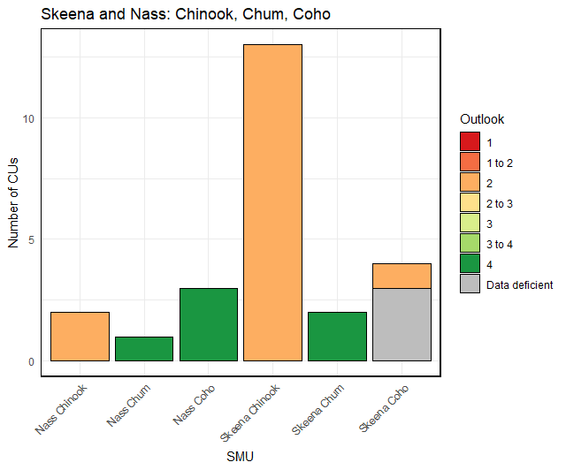
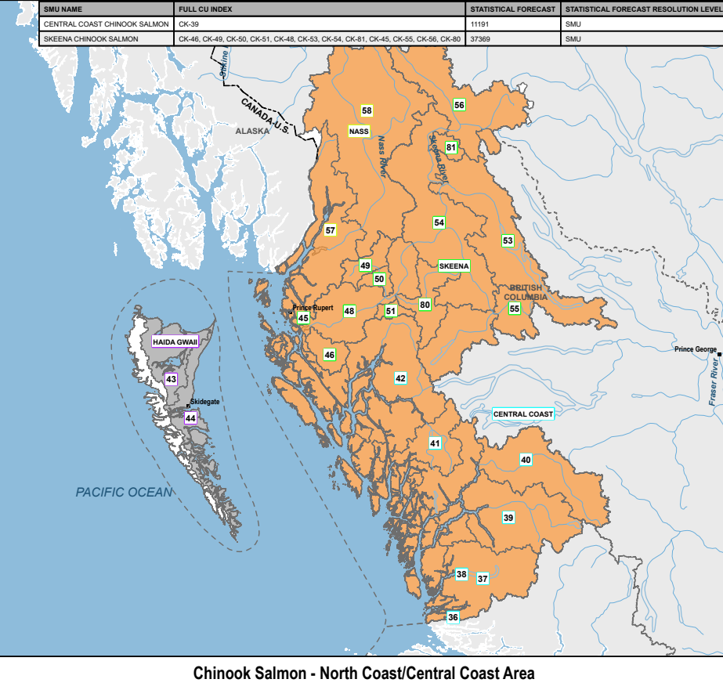
Skeena and Nass
Chinook, Chum, Coho
SMU | CU / Subunit | Outlook
Nass Chinook | Aggregate (2 CUs) | 2
Skeena Chinook | Aggregate (12 CUs) | 2
 | Kitsumkalum Indicator | 2
Nass Coho | Aggregate (3 CUs) | 4
Skeena Coho | Aggregate (3 CUs) | DD
 | Middle Skeena (1 CU) | 2
Nass Chum | Lower Nass (1 CU) | 4
Skeena Chum | Aggregate (2 CUs) | 4
Notes:
Expectations are for an average Somass Sockeye return in 2025, based on ocean indicators returns to date, and marine survival rates
Henderson: The 2024 adult return was low. The age composition data showed similar abundances of 42s and 52s. Expectations are for a below-average return.

Slide 14
2025 Preliminary Outlook Quick Reference
Yukon/Transboundary |  |  | North Coast/Central Coast |  |  |  |  | South Coast |  |  |  | Fraser River/BC Interior
Chinook |  |  | Chinook |  |  |  |  | Chinook |  |  |  | Chinook
ALSEK CHINOOK | 3 |  | CENTRAL COAST CHINOOK | 1 to 2 |  |  |  | LOWER GST CHINOOK | 4 |  |  | FRASER FALL RUN 41 CHINOOK | 3
PORCUPINE CHINOOK | 1 |  | HAIDA GWAII CHINOOK | DD |  |  |  | MAINLAND INLET CHINOOK | DD |  |  | FRASER SP RUN 42 CHINOOK | 1
STIKINE CHINOOK | 1 |  | NASS CHINOOK | 2 |  |  |  | MIDDLE GST CHINOOK | 2 to 3 | 4 |  | FRASER SP RUN 52 CHINOOK | 2
TAKU CHINOOK | 4 |  | SKEENA CHINOOK | 2 |  |  |  | UPPER GST CHINOOK | 3 |  |  | FRASER SU RUN 41 CHINOOK | 1 |  | 4
YUKON CHINOOK | 1 |  | Chum |  |  |  |  | WCVI CHINOOK | 1 | 4 |  | FRASER SU RUN 52 CHINOOK | 2
Chum |  |  | CENTRAL COAST CHUM | 1 | 2 | DD |  | Chum |  |  |  | OKANAGAN CHINOOK | 1
PORCUPINE CHUM | 1 to 2 |  | HAIDA GWAII CHUM | 1 to 2 |  |  |  | INNER SOUTH COAST CHUM | 2 to 3 |  |  | Chum
TRANSBOUNDARY CHUM | DD |  | SKEENA/NASS CHUM | 4 |  | DD |  | WCVI CHUM | 3 |  |  | FRASER CHUM | 2
YUKON CHUM | 1 to 2 |  | Coho |  |  |  |  | Coho |  |  |  | Coho
Coho |  |  | CENTRAL COAST COHO | 3 |  | DD |  | JST/MAINLAND INLET COHO | 2 |  |  | INTERIOR FRASER COHO | 2
ALSEK COHO | 3 |  | HAIDA GWAII COHO | DD |  |  |  | STRAIT OF GEORGIA COHO | 3 |  |  | LOWER FRASER COHO | Data Deficient
STIKINE COHO | DD |  | NASS COHO | 4 |  |  |  | WCVI COHO | 3 |  |  | Pink
TAKU COHO | 3 |  | SKEENA COHO | 2 |  | DD |  | Pink |  |  |  | FRASER PINK - ODD | 4
PORCUPINE COHO | DD |  | Pink |  |  |  |  | ECVI/MNLAND PINK- EVEN | N/A |  |  | Sockeye
Sockeye |  |  | CENTRAL COAST PINK | 2 | 3 | DD |  | ECVI/MNLAND PINK - ODD | 2 to 3 | 3 |  | FRASER SOCKEYE - ESTU | 1
ALSEK SOCKEYE | 3 |  | HAIDA GWAII PINK | DD |  |  |  | WCVI PINK | Data Deficient |  |  | FRASER SOCKEYE - ESUM | 1 | 2 | 4
STIKINE SOCKEYE | 2 to 3 |  | NASS PINK | 4 |  |  |  | Sockeye |  |  |  | FRASER SOCKEYE - LATE | 1 | 2 | 4
TAKU SOCKEYE | 4 |  | SKEENA PINK | 4 |  |  |  | ECVI/MAINLAND SOCKEYE | 1 | 2 |  | FRASER SOCKEYE - SUMMER | 1 | 3 | 4
 |  |  | Sockeye |  |  |  |  | WCVI - BARKLEY SOCKEYE | 2 | 3 |  | OKANAGAN SOCKEYE | 2
 |  |  | CENTRAL COAST SOCKEYE | DD |  |  |  | WCVI - OTHER SOCKEYE | Data Deficient
 |  |  | HAIDA GWAII SOCKEYE | 3 | DD
 |  |  | NASS SOCKEYE | 4
 |  |  | RIVERS/SMITH SOCKEYE | 1
 |  |  | SKEENA SOCKEYE | 4
4 bar charts by Area

Slide 15
2024 Final Outlook
For more details on average escapements and benchmarks, refer to the previous Outlook documents now available online.
Pacific salmon outlook, Pacific Region 2024.
https://waves-vagues.dfo-mpo.gc.ca/library-bibliotheque/41263625.pdf
2025 Final Outlook
To be posted at the link below once final forecasts are completed
Summary of Pacific salmon stock management units | Pacific Region | Fisheries and Oceans Canada

Slide 16

OUTLOOKS – FRASER AND INTERIOR
Chinook
SMU | CU | Outlook
CHECK | CHECK: No data entered | CHECK
CHECK | SOUTH THOMPSON-BESSETTE CREEK_SU_1.2 | 1 to 2
CHECK | SOUTH THOMPSON-BESSETTE CREEK_SU_1.2 | 2 to 3
CHECK | SOUTH THOMPSON-BESSETTE CREEK_SU_1.2 | CHECK
CHECK | LOWER THOMPSON_SP_1.2 | CHECK
CHECK |  | CHECK
Notes:
FRASER SPRING RUN 42 CHINOOK SALMON — CHECK: Data entered for the same SMU more than once: Test 2 FRASER SPRING RUN 42 CHINOOK SALMON — CHECK: Data entered for the same SMU more than once: Test 3 FRASER SPRING RUN 42 CHINOOK SALMON — CHECK: Data entered for the same SMU more than once: The 2024 field based escapement estimates were below the long-term average, the 2020 parental brood escapement, and the escapement target. Expectations are for continued low abundance in 2025 due to below-average parental escapements in 2021, the November 2021 flooding impacts on eggs (age-4) and parr (age-5), and uncertainty around marine survival and productivity. (2024 Outlook Category 2) FRASER SPRING RUN 42 CHINOOK SALMON — CHECK: Data entered for the same SMU more than once: Test data

Slide 17
OUTLOOKS – FRASER AND INTERIOR
Chum
SMU | CU | Outlook
CHECK | FRASER CANYON | 1 to 2
CHECK | FRASER CANYON | 4
CHECK | LOWER FRASER | 2
CHECK | LOWER FRASER | CHECK
Notes:
FRASER CHUM SALMON — CHECK: Data entered for the same SMU more than once: N/A FRASER CHUM SALMON — CHECK: Data entered for the same SMU more than once: Fraser River Chum Salmon spawning escapement has failed to reach the management target in six of the last eight years (2017-2021, 2023). Spawning escapements failed to outperform brood for 2017-2021, while spawning escapements outperformed brood in the most recent three years (2022-2024). The 2024 in-season terminal run estimate was 1,126,000 fish and the 2024 spawning escapement estimate (including age data) will be available by May 2025. Returns in 2025 will be dominated by 4-year-old brood from the 2021 escapement of 533,000 spawners. 2021 saw a historic flooding event during the Chum spawning period that will likely have a negative impact on recruitment. The Lower Fraser Chum CU is assigned an Outlook Category 2 for 2025. (2024 Outlook Category was 2) FRASER CHUM SALMON — CHECK: Data entered for the same SMU more than once: testing entering for entire SMU

Slide 18
OUTLOOKS – FRASER AND INTERIOR
Sockeye River Type
SMU | CU | Outlook
FRASER SOCKEYE SALMON - SUMMER | HARRISON RIVER | 1 to 2
FRASER SOCKEYE SALMON - SUMMER | WIDGEON | CHECK
Notes:
FRASER SOCKEYE SALMON - SUMMER: na

Slide 19
OUTLOOKS – FRASER AND INTERIOR
Coho
SMU | CU | Outlook
INTERIOR FRASER COHO SALMON | FRASER CANYON | CHECK
INTERIOR FRASER COHO SALMON | INTERIOR FRASER | CHECK
INTERIOR FRASER COHO SALMON | NORTH THOMPSON | CHECK
INTERIOR FRASER COHO SALMON | LOWER THOMPSON | CHECK
INTERIOR FRASER COHO SALMON | SOUTH THOMPSON | CHECK
Notes:
INTERIOR FRASER COHO SALMON: The PST MU status will remain Low in 2025, as the Moderate status reference point survival target has not been met; three consecutive years of survival over 3% are required for a change in status (the preliminary 2023 survival estimate was 2.2%). Recent escapements exceed Canadian Fish Stock Provision limit reference points and total pre-fisheries abundance has improved but remains well below historical averages. (2024 Outlook Category 2)

Slide 20
OUTLOOKS – FRASER AND INTERIOR
Sockeye Lake Type
SMU | CU | Outlook
OKANAGAN SOCKEYE SALMON | OSOYOOS-SKAHA-OKANAGAN | CHECK
Notes:
OKANAGAN SOCKEYE SALMON: 50% credible interval: 61,000-112,000 80% credible interval: 345,000-156,000 95% credible interval: 34,000-246,000 This preliminary forecast suggests a below-average return year, primarily due to: A lower-than-average estimated number of smolts out-migrating in 2023 (odd-numbered return years typically have lower-than-average returns because of reduced smolt numbers in the dominant returning age class). Regional climate conditions that are likely resulting in below-average marine conditions for Okanagan Sockeye. In comparison, 2024 had the highest returns for this SMU since at least the 1930s, and this was likely due to higher-than-average smolt numbers in the dominant returning age class and better-than-average marine conditions. This preliminary forecast is based on a Bayesian smolts-to-adult-recruits model for Osoyoos lake fish that includes a suite of environmental covariates including regional climate indices, ocean entry conditions (zooplankton, sea surface temperature, salinity, upwelling), and an index of pink salmon abundance, as well as temperature and flow experienced in the downstream migration. The model structure was developed using causal inference theory to account for the interrelationships among these covariates and their collective influence on sockeye survival The model does not directly estimate smolt to adult recruit (SAR) survival for Skaha and Okanagan Lake. For these lakes, estimates of smolt abundance were multiplied by the estimated SAR for Osoyoos lake in each year. Thus, the contribution of Skaha and Okanagan Lake to the returns is an additional source of uncertainty that is not accounted for in our forecast uncertainty.

Slide 21
OUTLOOKS – YUKON TRANSBOUNDARY
Chum
SMU | CU | Outlook
PORCUPINE CHUM SALMON | Outlook assigned but no CU specified | 1
Notes:
PORCUPINE CHUM SALMON: testing if paragraphs show up does this work??

Slide 22
OUTLOOKS – YUKON TRANSBOUNDARY
Coho
SMU | CU | Outlook
STIKINE COHO SALMON | LOWER STIKINE | 3
PORCUPINE COHO SALMON | PORCUPINE | Data Deficient
Notes:
STIKINE COHO SALMON: hi chelsea! happy thursdayyyyyyy PORCUPINE COHO SALMON: Very little is known about Coho Salmon stock status within Canadian portions of the Yukon River drainage. Data from the U.S. portion of the drainage suggest runs to the drainage have been below average in three of the past five years, with a declining trend. No assessment programs are currently undertaken in Canada and the current stock status is unknown. It is known that coho salmon primarily return as 4-year-olds and overlap with the tail end of the fall chum run. TAKU COHO SALMON: Based on preliminary smolt abundance in 2024 combined with recent smolt-to-adult survival rates, an average run above the management target of 70,000 is expected for 2025. Run is an even split of 3 and 4 year olds.

Slide 23
OUTLOOKS – YUKON TRANSBOUNDARY
Sockeye Lake Type
SMU | CU | Outlook
STIKINE SOCKEYE SALMON | CHUTINE | 2
STIKINE SOCKEYE SALMON | TAHLTAN | 3
STIKINE SOCKEYE SALMON | CHRISTINA | 2
Notes:
ALSEK SOCKEYE SALMON: Based on brood year escapements that were both above and below the MSY target range and stock-recruitment relations from historical records, a below average, but within the escapement goal range run is expected. This aggregate stock is dominated by lake and river type age 5 fish. STIKINE SOCKEYE SALMON: Based on a combination of primary brood year smolt counts and sibling-based predictions, an average run is anticipated for 2025 and it is expected escapement objectives will be achieved. This is an aggregate stock of lake and river type 5 year olds.

Slide 24
OUTLOOKS – SOUTH COAST
Chinook
SMU | CU | Outlook
LOWER GEORGIA STRAIT CHINOOK SALMON | EAST VANCOUVER ISLAND-GOLDSTREAM_FA_0.X, EAST VANCOUVER ISLAND-NANAIMO AND CHEMAINUS_FA_0.X | 1
LOWER GEORGIA STRAIT CHINOOK SALMON | EAST VANCOUVER ISLAND-COWICHAN AND KOKSILAH_FA_0.X | 3 to 4
MIDDLE GEORGIA STRAIT CHINOOK SALMON | EAST VANCOUVER ISLAND-NANAIMO_SP_1.X, SOUTHERN MAINLAND-GEORGIA STRAIT_FA_0.X, EAST VANCOUVER ISLAND-GEORGIA STRAIT_SU_0.3, EAST VANCOUVER ISLAND-QUALICUM AND PUNTLEDGE_FA_0.X | 1
WCVI CHINOOK SALMON | Outlook assigned but no CU specified | 1
WCVI CHINOOK SALMON | WEST VANCOUVER ISLAND-NOOTKA AND KYUQUOT_FA_0.X | 1
WCVI CHINOOK SALMON | WEST VANCOUVER ISLAND-NORTH_FA_0.X | 1
Notes:
LOWER GEORGIA STRAIT CHINOOK SALMON: he Upper Pitt CU has a higher proportion of five-year-old recruits (~78%) relative to four-year-old recruits'; an aggregate of CUs, e.g., 'For the Rivers aggregate (Wannock River and Owikeno Lake CUs), low returns are expected and the Owikeno Lake productivity based on the Clear Streams Index continues to be below average'; or a particular Area, e.g., 'PFMA Area 3 Chum are expected to be average to above average in 2024 MIDDLE GEORGIA STRAIT CHINOOK SALMON: Testing WCVI CHINOOK SALMON: Escapements of WCVI Chinook natural populations remain low. There has been improvement in Kyuquot (NWVI wild indicators) in recent years. The Clayoquot area (SWVI wild indicators), which remains the biggest concern, saw a drop in 2024 relative to the slight improvement over the previous two years. It is assumed survival rates of natural-origin Chinook are well below those of hatchery-origin Chinook and this discrepancy may be related to the much smaller sizes of natural out-migrating smolts; productivity is therefore anticipated to remain low. WCVI wild Chinook remain a stock of concern. Returns of hatchery Chinook stocks to the WCVI were strong in 2024, consistent with the favourable ocean-entry conditions observed in 2021 and fair in 2022. Conditions in the 2022 and 2023 ocean-entry year appear fair; therefore, expectations are for an average return in 2025. MAINLAND INLET CHINOOK SALMON: Includes Homathko and Klinaklini. DFO is working to expand our programs into the Mainland Inlets. Since 2021, a video counter was installed on Devereux Creek and average annual returns are 850, although additional data review is required. Since 2022, an intensive mark-recapture project has been undertaken on the Southgate River in Bute Inlet and estimated returns have ranged from 832 to 5,175. Although still data deficient, efforts are underway to understand population abundance and trends in these areas.

Slide 25
OUTLOOKS – SOUTH COAST
Pink Even
SMU | CU | Outlook
CHECK | GEORGIA STRAIT | 1 to 2
CHECK | GEORGIA STRAIT | 3
CHECK | SOUTHERN FJORDS | 2 to 3
Notes:
ECVI/MAINLAND PINK SALMON - EVEN — CHECK: Data entered for the same SMU more than once: never, but I would love to ECVI/MAINLAND PINK SALMON - EVEN — CHECK: Data entered for the same SMU more than once: Even Year: 2024 saw improved returns throughout the South Coast with returns approaching or exceeding the long-term average for systems on Vancouver Island and in the Mainland Inlets. Returns were somewhat below the long-term average for the mainland, but most systems exceeded the recent (3 cycle) generational average. Expectations for 2026 are for a stabilization of abundance for Pink Salmon returning to ECVI and the mainland. Pink returns are highly variable, and confidence in the forecasted return in 2026 is low, but average returns to this region are expected in 2026 Odd Year: 2023 saw varied returns throughout South Coast, but generally abundance increased over the brood year. Returns to Northern Vancouver Island were below the historical adult abundance, although with clear signs of improvement since escapement hit its lowest point in 2016/2017. The mainland inlets in Area 12 saw continued poor escapement of Pink Salmon, but again with improvements over the brood year. Expectations north of Adam River are for continued improvements in 2025, with potential to approach the long-term average escapement. Particularly strong returns were observed in 2023 to major systems including Adam, Quinsam, Tsolum and Jervis Inlet while unenhanced returns to Big Qualicum continue to grow. Above average escapements to these systems and promising fry counts from the Quinsam River suggest that we will see average to above average escapements for systems south of Adam River in 2025.

Slide 26
OUTLOOKS – SOUTH COAST
Sockeye Lake Type
SMU | CU | Outlook
WCVI - BARKLEY SOCKEYE SALMON | GREAT CENTRAL | 3
WCVI - BARKLEY SOCKEYE SALMON | SPROAT | 3
WCVI - BARKLEY SOCKEYE SALMON | HENDERSON | 2
Notes:
WCVI - BARKLEY SOCKEYE SALMON: Sproat Lake CU: The two main contributing brood years to the 2025 run are 2020 and 2021 and the two main contributing smolt years are 2022 and 2023. Brood abundances were below average in 2020 and 2021 particularly in Great Central Lake, but improved relative to 2019. Smolt abundances were low in both Great Central Lake and Sproat Lake in 2022 and 2023. Based on ocean indicators and returns to date, marine survival rates for the 2022 and 2023 smolt years are - good. Given the considerations above, expectations are for an average Somass Sockeye return in 2025. Henderson Lake CU: For the 2025 return, the two main contributing brood years are 2020 and 2021 and the two main contributing smolt years are 2022 and 2023. Brood abundance was low in 2020 but improved in 2021. Based on ocean indicators, marine survival rates for the 2022 and 2023 smolt years are likely average in 2023. The 2024 Henderson adult return, however, was low and the age composition data showed similar abundances of 42s and 52s. this may bias the outlook downward to a below-average return.

Slide 27
OUTLOOKS – NORTH COAST
Coho
SMU | CU | Outlook
SKEENA COHO SALMON | SKEENA ESTUARY | Data Deficient
SKEENA COHO SALMON | UPPER SKEENA | Data Deficient
SKEENA COHO SALMON | LOWER SKEENA | Data Deficient
SKEENA COHO SALMON | MIDDLE SKEENA | 2
Notes:
SKEENA COHO SALMON: Middle Skeena Toboggan Creek indicator counts were above average in 2022 and 2023. In 2024, there was a below average return of 2099 coho. 2024 Babine River Counts were also below average in 2024. The Skeena Estuary and Upper Skeena CUs are data deficient. Methods to estimate escapement all Skeena CUs using genetics are currently under review.

Slide 28
OUTLOOKS – NORTH COAST
Chinook
SMU | CU | Outlook
HAIDA GWAII CHINOOK SALMON | Outlook assigned but no CU specified | 2
HAIDA GWAII CHINOOK SALMON | Outlook assigned but no CU specified | 1
Notes:
HAIDA GWAII CHINOOK SALMON: sss CENTRAL COAST CHINOOK SALMON: Bella Coola returns are expected to be below average based on returns in recent years. The 2024 Atnarko River Wild & Enhanced Maximum likelihood model escapement is not yet available but the Peterson escapement estimate was 17, 210. Specific escapement estimates to the Nusatsum, and Saloompt are data deficient. Areas 7 and 8 3 CUs – Dean River Data Deficient . Areas 9 and 10 – Aggregate includes 3 CUs Data Deficient/ Outlook Category 1/ . Owikeno tributary, Wannock River and Docee Chinook returns are unknown. There are multi-species sonar assessments on both the Wannock and Docee Rivers but estimates are data deficient. Recent Chuckwalla/Kilbella returns are well below average based on recent trends.

